Slide 1


CalFresh Application
A Step-by-Step Guide
For UCSF Professional Students ed. 2025-2026

Slide 2

Step-By-Step Instructions
Create an Account through BenefitsCal.
It is recommended that you create an account to apply for benefits. By creating an account, it will allow you to save your information and go back to finish later.

Slide 3
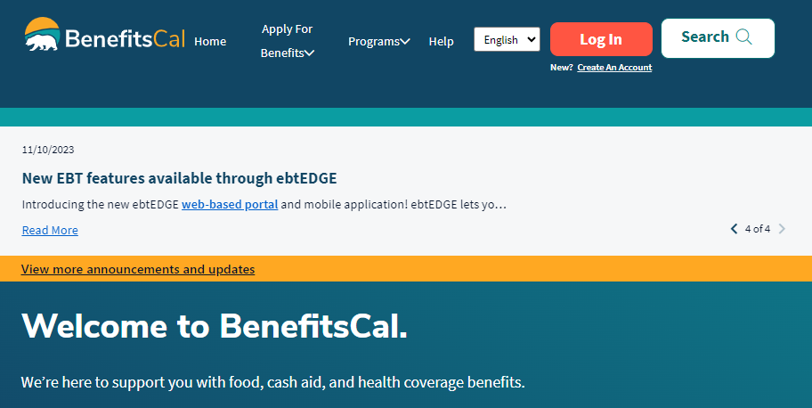
Creating an account
Visit https://benefitscal.com/ and select "Create an Account"
  Select your county - Choose the county you will be living in for the next 3-6 months
  Enter email and create password
  Select three security questions
Log into your account and select "Start a new application"

Slide 4
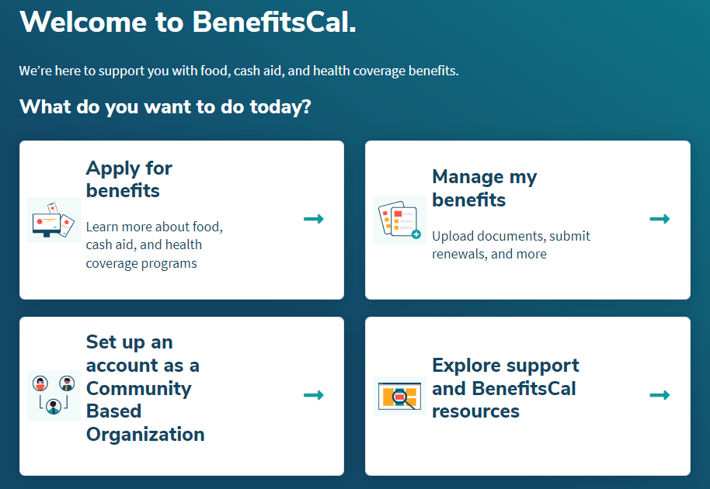
Applying for Benefits
If you chose not to create an account, you can visit https://benefitscal.com/ and select "Apply for benefits"

Slide 5
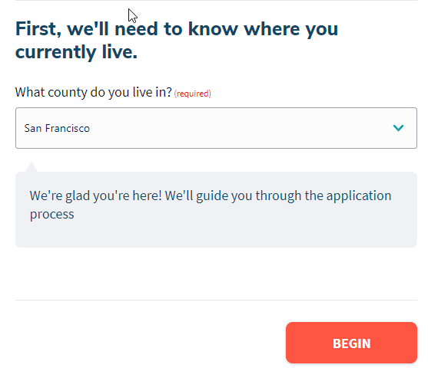
Applying for Benefits
Select your county
  Choose the county you will be living in for the next 3-6 months
Click "Begin"

Slide 6
Documentation required to apply
When you apply for benefits, you will be asked to provide:
  Proof of identification
  Copy of your pay stubs
  Bills you pay (Rent, Utilities, Childcare)
  School Documentation
    Complete the School Documentation for CalFresh to request documents that confirm your Federal Work Study Eligibility and Full Time Enrollment to qualify for Student Exemptions

Slide 7
What to expect when applying for CalFresh
Complete and submit your application
Upload documents
The county will review your application
They will reach out to schedule your phone interview

Slide 8
Step 1. Your information
Enter your preferred languages to:
  Read
  Speak
  To complete the application
Need help to apply?
  You may contact your local county office to provide you with an interpreter or help filling out your application. Our office cannot coach or attend interviews with our students.
Enter your First name and Last name

Slide 9
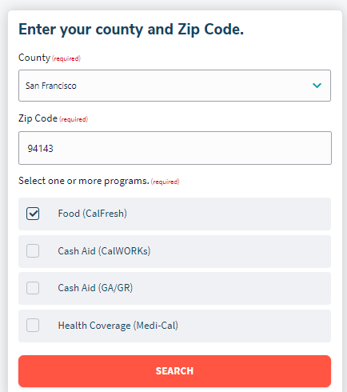
Step 1. Your information
Are you a person with a disability? - Select "Yes" or "No"
Are you a person who is deaf or hard of hearing? - Select "Yes" or "No"
If you need help filling out your application, click "please contact your local county office":
  Select your county
  Enter your Zip code
  Select "Food (CalFresh)" program
  Select "Search" for a list of local county offices

Slide 10
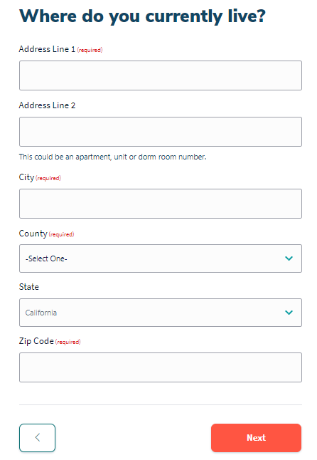
Step 1. Your information
Are you a college student? - Select "Yes"
Are you a person experiencing homelessness? - Select "Yes" or "No“
  This could include “couch surfing” not having a stable or consistent place to live for the next 3-6 months or not having an address where you can receive mail.
Where do you currently live? - Enter Address, City, County, State, and Zip code
  Provide an address at which you will be able to receive mail for at least 3 months
  Or enter the address where you receive mail if it is different than the address where you live

Slide 11
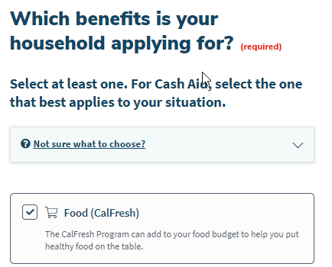
Step 1. Your information
Which benefits are you applying for? - Select "Food (CalFresh)"
Are you applying for benefits for yourself? - Select "Yes"
Do you want to authorize someone to help you with your CalFresh case?
  If you are unable to complete the application process or use the EBT card yourself, you can select an Authorized Representative
  Our office cannot be an authorized representative for any of our students
  This is generally for people with caretakers or others who act on their behalf

Slide 12
Step 1. Your information
Enter your contact info: Home phone, Mobile phone, Email
Select if you would like to receive text and email alerts for your application
Enter your Date of Birth
Enter your gender, gender identity, sexual orientation (optional)
Provide your SSN
Provide your marital status
Are you a U.S citizen or national?
  Only Citizens and Permanent Residents are eligible to receive CalFresh Benefits.
  If you are an international or undocumented student, you cannot apply for CalFresh, however there are other forms of assistance available through our office. You can reach out to us directly at finaid@ucsf.edu
Are you of Hispanic, Latino, or Spanish origin? What is your race and ethnic origin? (optional)

Slide 13
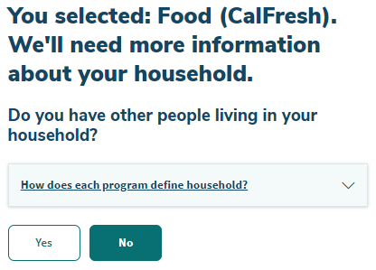
Step 2. People
Do you have other people living in your household?
  Whether or not you live with other people, you can apply for CalFresh as a single person household as long as you purchase and prepare food for yourself. Most of our students apply as a single person household even if they have roommates.
  If you claim other people in your household, you will have to submit their information on your application and their income will be counted toward the total household income.

Slide 14
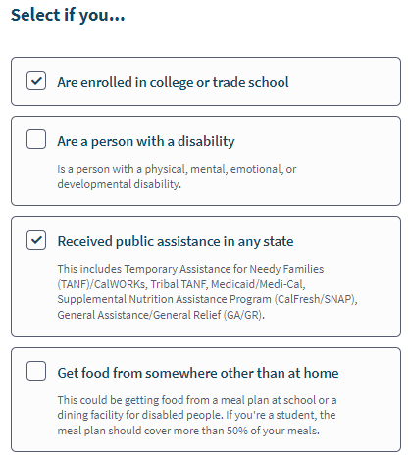
Step 3. Household Details
Select all that apply to you
Our office will help support your application under student exemptions
Selecting “Are enrolled in college or trade school” will direct you to further student questions

Slide 15
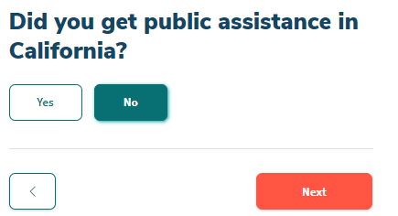
Step 3. Household Details
If you received public assistance before, provide the county where you received public assistance
  This includes Medi-Cal or CalFresh/SNAP

Slide 16
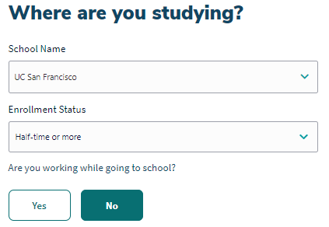
Step 3. Household Details
List UCSF as your school
Enrollment status – Select "half-time or more"
Are you working while going to school? - Select "Yes" or "No“ depending on what is true for your circumstances

Slide 17

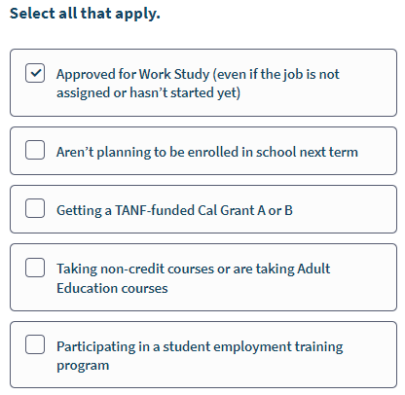
Step 3. Household Details
Do any of the student situations below apply to you?
  College students must meet specific factors to qualify for CalFresh. Select all the student situations that apply to you. It may help you qualify for CalFresh.
  You can select "Approved Work Study" even if you do not currently hold a Work Study job
  Work Study is a popular eligibility consideration for many students. Financial Aid can verify and document your eligibility.
    Click here to request School Documentation for CalFresh

Slide 18
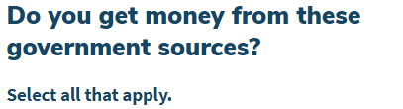
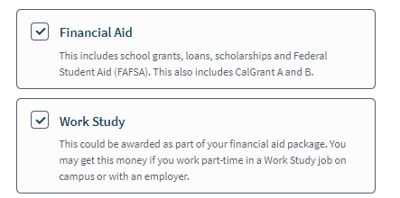
Step 4. Income
Do you have a job?
  If you receive Work Study income, you do not need to report this income here
Do you get money that doesn't come from work?
  Select "Yes" if you receive Financial Aid, Work Study, Gifts of money from your parents
Money that doesn't come from work includes:
  Work Study income
  PhD and HPSP stipends
Select the government sources you receive money. For most of our students that includes:
  Financial aid
  Work study

Slide 19
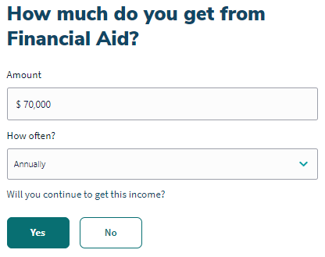
Step 4. Income
Amount
  Enter your Total amount awarded for the academic year. This can be found on the Awards Breakdown tab in your Financial Aid Student Portal (https://finaid.ucsf.edu)
How often? - Select "Annual"
Will you continue to get this income?
  Select "Yes" if you will be a continuing student for the following academic year

Slide 20
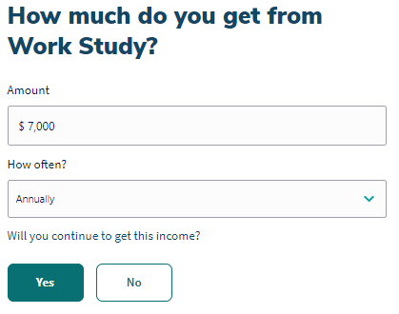
Step 4. Income
If you have a Federal Work Study job:
Amount
  Enter your Work Study award for the academic year
  This can also be found on the Awards Breakdown tab in your Financial Aid Student Portal (https://finaid.ucsf.edu/)
How often? - Select "Annual"
Will you continue to get this income?
  Select "Yes" if you will continue working as a Federal Work Study student in the following academic year

Slide 21
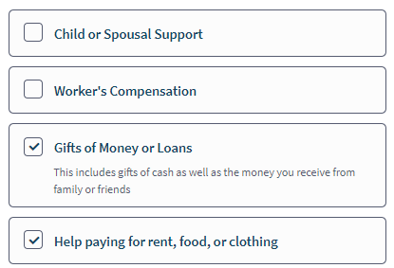
Step 4. Income
Select money you receive from any other sources or select "None of these apply"
If you are receiving support from family members or outside sources for housing, your family or outside agency will need to pay your housing directly so it is considered a vender payment rather than in-kind income.
If your parents or outside agency send you money that you in turn use to pay your rent, it will be treated as in-kind income and added to the total income to meet the thresholds for eligibility.

Slide 22
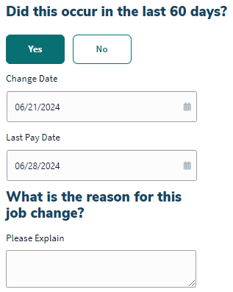
Step 4. Income
Are you on strike? - Select "Yes" or "No"
  If "Yes", provide date of when your strike began, last pay date, and reason for the strike at work
Did your employment change in the last year?
  For incoming students, select "Yes" if you left a job in the last 60 days before starting school
    Provide change date, last pay date, and reason for leaving job

Slide 23
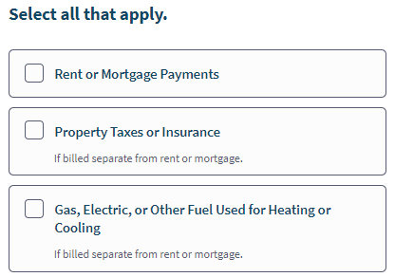
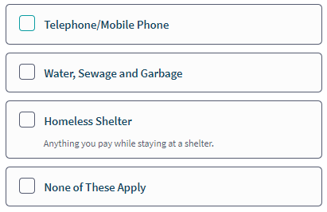
Step 5. Expenses
Select all the expenses that apply to you or select "None of these apply"

Slide 24
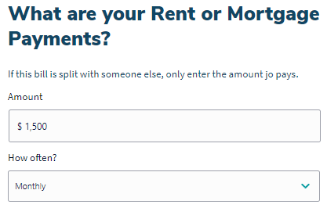
Step 5. Expenses
Enter the amount you pay in rent.
Select how often you pay
Repeat for all expenses you listed.

Slide 25
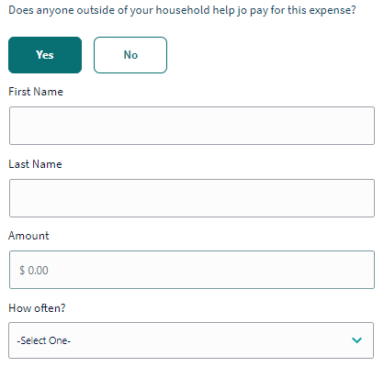
Step 5. Expenses
Does anyone outside of your household help you pay for this expense?
  If you are receiving support from family members or outside sources for housing, your family or outside agency will need to pay your housing directly so it is considered a vender payment rather than in-kind income.
  If your parents or outside agency send you money that you in turn use to pay your rent, it will be treated as in-kind income and added to the total income to meet the thresholds for eligibility.

Slide 26
Step 5. Expenses
Do you pay for adult care or childcare so you can go to work, school, or look for a job? - Select "Yes" or "No"
  This could include:
    Care for a child, disabled adult, other dependents
  If "Yes", enter cost, how often you pay, and care provider information
Do you pay court-ordered child support? - Select "Yes" or "No"
  If "Yes", provide name of children, amount of childcare you pay, and how often you pay
Do you have court-ordered spousal support or alimony expenses? - Select "Yes" or "No"
  If "Yes", provide the amount you pay and how often you pay

Slide 27
Step 6. Other Situations
Answer the following Yes/No questions:
  Have you been convicted of:
    Receiving duplicate food assistance in any state after 09/22/1996?
    Trafficking (trading or selling) EBT cards worth $500 or more after 09/22/1996?
    A parole or probation violation?
  Have you been found guilty of:
    Trading food assistance for drugs in any state after 09/22/1996?
    Trading food assistance for guns, ammunitions, or explosives after 09/22/1996?
  Are you:
    Hiding or running from the law for a felony crime or attempted felony crime?

Slide 28
Step 7. Document Upload
Based on your responses in the application, supporting documentation will be requested
You will need to submit at least:
  Government Photo ID
  Lease or rental agreement
  Verification of SSN
You can upload the supporting documents from our office to support your application under student exemptions
Now you are ready to Review and Submit

Slide 29
Step 8. Next Steps
Congratulations! You successfully submitted your CalFresh application.
There will be a telephone interview with a county caseworker.
If you did not submit all your supporting documents, you can go back into your BenefitsCal account and upload them as soon they are available.
Receive approval or denial of your application within 30 days by mail
Receive your EBT card by mail in one week once approved

Slide 30
CalFresh Questions?
UCSF Student Financial Services Office
San Francisco County
Location, Contact, Hours
500 Parnassus Ave MU-201W Phone: (415) 476-4181 Office Open:
San Francisco, CA 94143 Fax: (415) 476-6652 Monday–Friday Email: finaid@ucsf.edu 8am - 5pm
SFHSA Service Centers offer program assistance in-person or by phone.
Details for each location and the services they provide are available through their website: https://www.sfhsa.org/contact-us/locations

